Slide 1
Nome do projeto
Nome:
Tutor:
Período de Estágio:

Slide 2
Problem Statement

Slide 3
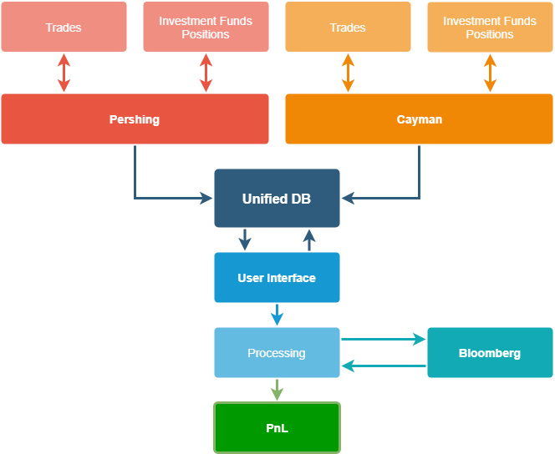
Algorithm Flow Chart

Slide 4
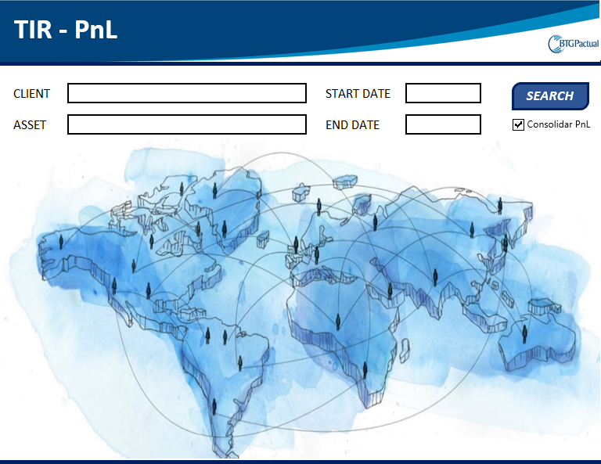
User Interface

Slide 5
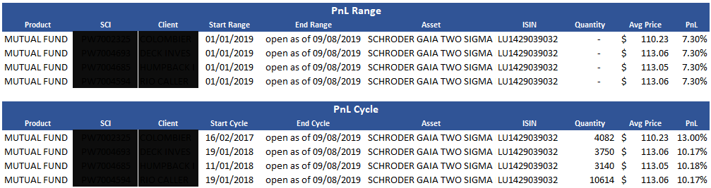
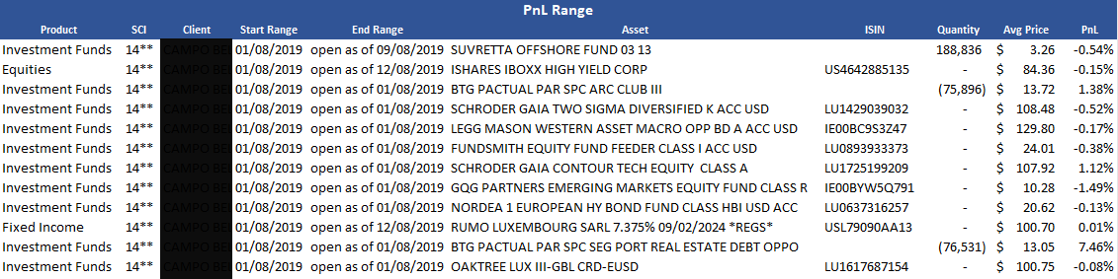
Results

Slide 6
Impact

Slide 7
Problem Statement

Slide 8
Algorithm Flow Chart

Slide 9
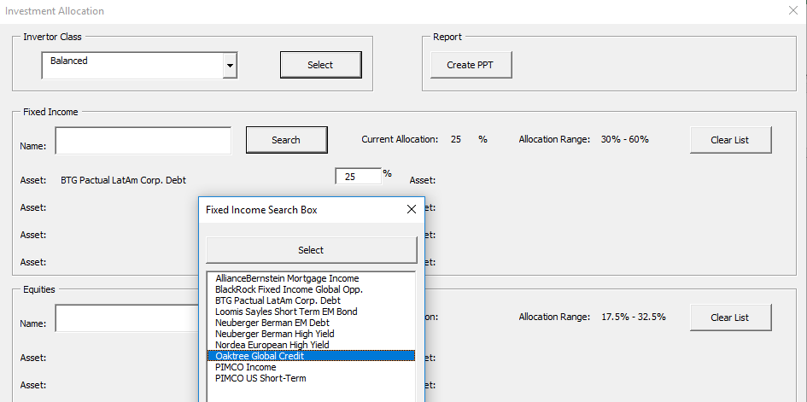
User Interface

Slide 10

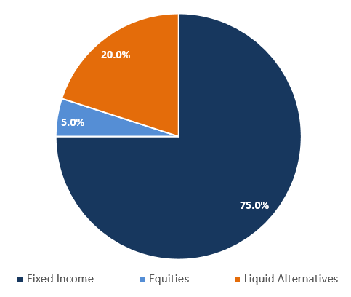
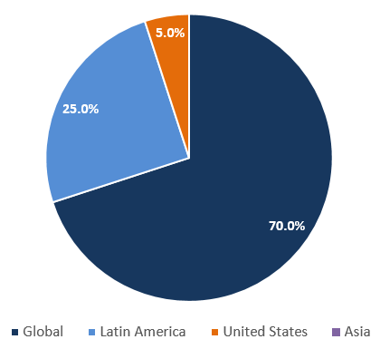

Consolidated Allocation
Suggested Allocation
 | Asset Class | Weight |  | Instrument | Geography | Strategy | Liquidity
 | Fixed Income | 75.0% | 25.0% | BTG Pactual LatAm Corp. Debt | Latin America | Corporate Debt | Daily
 |  |  | 25.0% | Oaktree Global Credit | Global | Investment Grade | Daily
 |  |  | 25.0% | PIMCO Income | Global | Unconstrained | Daily
 |  |  | 0.0%
 | Equities | 5.0% | 5.0% | Harris Associates US Equity | United States | Large Cap Value | Daily
 |  |  | 0.0%
 | Liquid Alternative Investments | 20.0% | 20.0% | Western Asset Macro Opportunities | Global | Macro Rates & FX | Monthly
 |  |  | 0.0%

Slide 11
Consolidated Returns
Proforma Return
Asset | Weight | 2019 | 2018 | 2017 | 2016 | 2015 | Since 2015 | Ann. Return | Volatility
BTG Pactual LatAm Corp. Debt | 25.0% | 12.7% | -1.6% | 11.8% | 16.3% | -13.1% | 25.4% | 5.2% | 2.8%
Oaktree Global Credit | 25.0% | 7.1% |  |  |  |  | 7.1% | 1.5% | 2.0%
PIMCO Income | 25.0% | 6.0% | -0.7% | 6.4% | 7.4% | 2.0% | 22.6% | 4.6% | 1.9%
Harris Associates US Equity | 5.0% | 18.1% | -14.2% | 15.5% | 15.2% | -8.9% | 22.9% | 4.7% | 16.3%
Western Asset Maco Opportuniteis | 20.0% | 8.7% | -5.6% | 13.5% | 6.6% | 1.2% | 25.6% | 5.2% | 6.1%
Pro Forma Return | 100.0% | 9.1% | -2.4% | 8.0% | 8.0% | -3.0% | 20.5% | 4.2% | 1.8%
BB Global Aggregate | Benchmarks | 7.1% | -1.2% | 7.4% | 2.1% | -3.2% | 12.4% | 2.6% | 3.2%
BB US Corporate |  | 12.7% | -2.5% | 6.4% | 6.1% | -0.7% | 23.2% | 4.8% | 3.5%
BB US Treasury |  | 7.8% | 0.9% | 2.3% | 1.0% | 0.8% | 13.3% | 2.8% | 3.3%
MSCI All Countries |  | 13.9% | -8.9% | 24.7% | 8.5% | -1.8% | 37.8% | 7.4% | 11.4%
S&P 500 |  | 17.8% | -4.4% | 21.8% | 12.0% | 1.4% | 55.8% | 10.4% | 15.4%
MSCI EM |  | 3.6% | -14.3% | 37.8% | 11.7% | -14.6% | 16.8% | 3.5% | 14.2%
Global HF Index |  | 4.9% | -6.7% | 6.0% | 2.5% | -3.6% | 2.4% | 0.5% | 3.1%
BB Commodities |  | 0.9% | -13.0% | 0.7% | 11.4% | -24.7% | -25.8% | -6.4% | 11.7%
Gold |  | 17.1% | -0.9% | 12.7% | 8.1% | -12.1% | 24.2% | 4.9% | 10.4%

Slide 12
Sample Asset

Slide 13
Impact

Slide 14
Final Considerations

